Slide 1
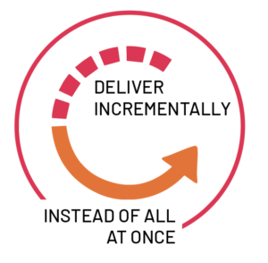
AGILE-SCRUM Development Model

Slide 2
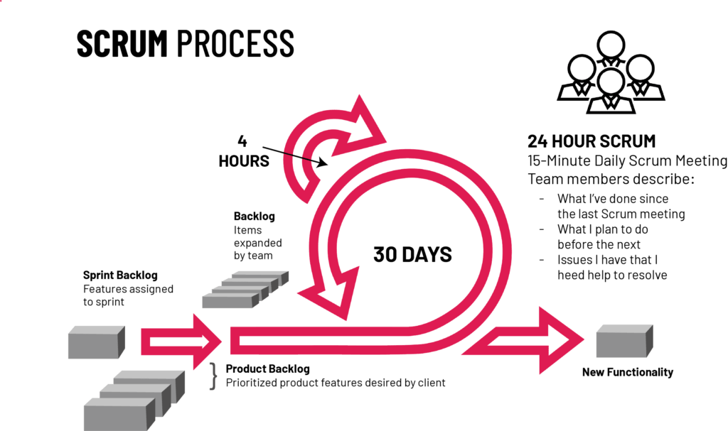

Slide 3
Drawbacks of LIAR Dataset
US Specific, cannot be used for India
Only contains statements made by US speakers
Limited time coverage (2007-2016)
More skewed towards Truth
The lack of dates translate to lack of historical information
Considered hard to classify due to lack of sources or knowledge bases to verify with.

Slide 4
Further Work and Learning Points
Clearly, the LIAR dataset is insufficient for determining whether a piece of news is fake. Future work could include the following:
Supplement with other fake news datasets or API’s.
focusing on identifying sources of fake news rather than, or in addition to, identifying whether a piece of news is fake.
Apply different models e.g. gradient boosting or recurrent neural networks.
Use more advanced NLP tools, e.g. part-of-speech analysis or Google’s BERT model.

